Slide 1
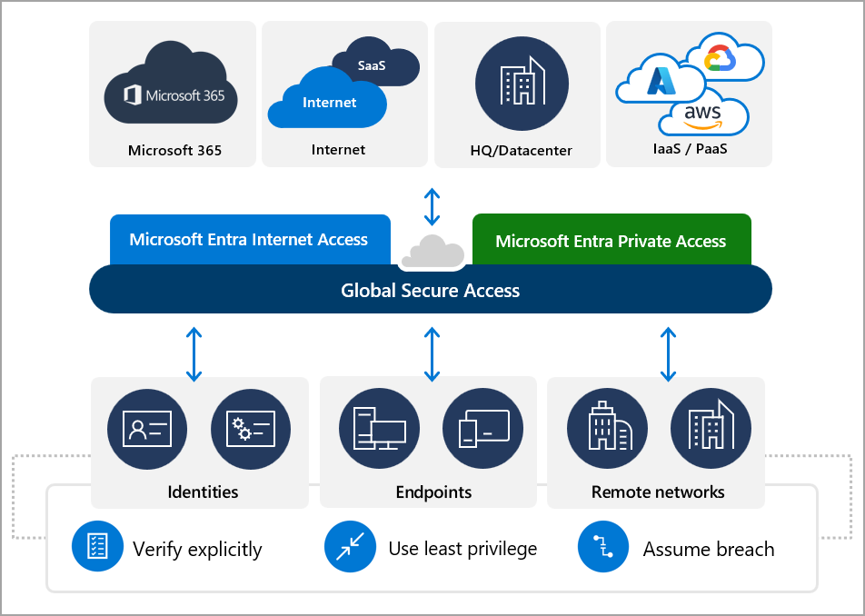
What is Global Secure Access?
Global Secure Access (GSA) is the unifying term for both of Microsoft’s Security Service Edge (SSE) solutions:
Microsoft Entra Internet Access and
Microsoft Entra Private Access
Internet Access
Private Access

Slide 2




Traffic profiles & licensing overview
An identity-centric SSE solution
Microsoft Entra Private Access
Secure access to all private apps and resources, with an identity-centric Zero Trust Network Access (ZTNA)
Microsoft Entra Internet Access
Secure access to all internet and SaaS apps and resources while protecting your organization against internet threats
Internet Access for Microsoft Services
Enhance Microsoft Entra ID capabilities with direct connectivity to supported Microsoft services, improving security, performance and resilience. Included in Entra ID P1.
Private Traffic
Internet Traffic
Microsoft Traffic
How to purchase
Entra Suite (Internet Access, Private Access, ID Governance, ID Protection, & Verified ID)
Entra Private Access SKU (Private traffic)
Entra Internet Access SKU (Internet traffic
Entra ID P1 License (Microsoft traffic)

Slide 3
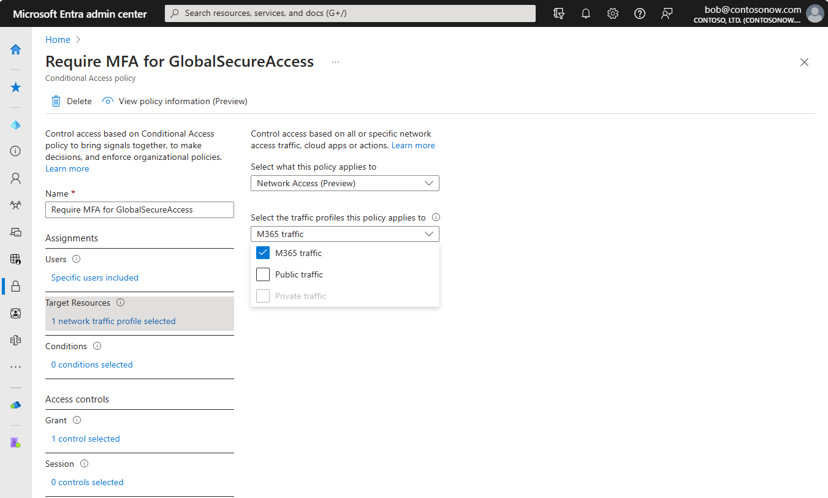
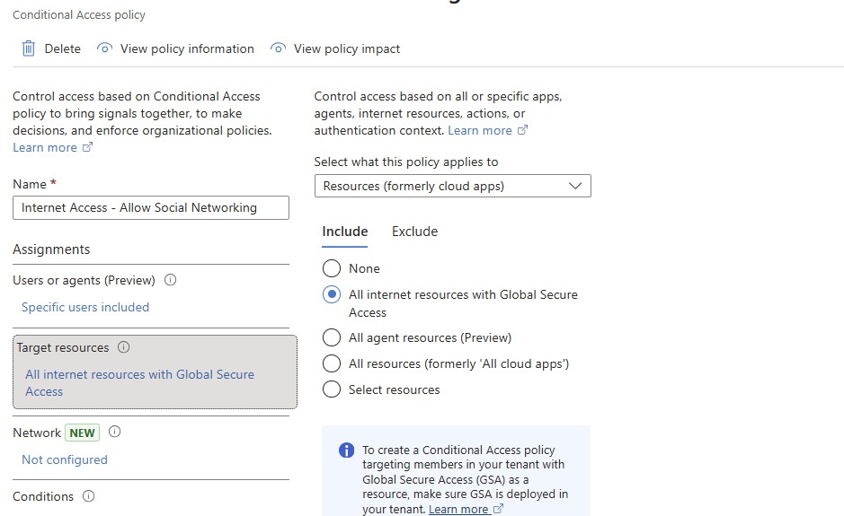
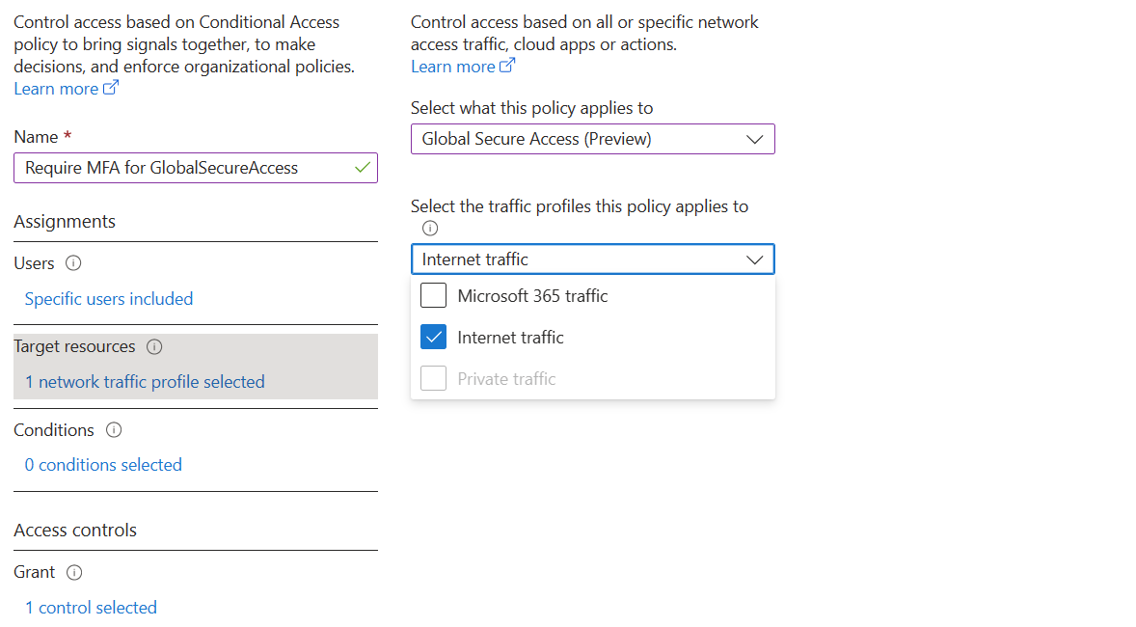

Apply adaptive access controls to any network destination Extend Conditional Access (CA) and continuous access evaluation universally
Enforce Conditional Access conditions and controls to all internet destinations
Secure and govern internet access alongside cloud app access through a unified Zero Trust policy engine
Apply continuous access evaluation to revoke access in near real time when conditions change
Link context aware CA policies to relevant network security profiles
Leverage Conditional Access to validate access for any network destination

Slide 4








Protect users with context aware network security Rich user, device, location, and risk awareness of CA for network security policy enforcement
Identity/workload, groups, roles
Internet apps and resources
Security service edge
Conditional Access and continuous access evaluation
Risk
Allow
Microsoft apps
Trusted and compliant devices
Require
Entra Internet Access gateway*
Microsoft traffic gateway*
Internet endpoints, websites
Block
Apps and data
Network security*
SaaS applications
Location
Compliant network
IaaS / PaaS / datacenter

Slide 5
Protect against token replay attacks Provide defense in-depth with new compliant network check integrated with Microsoft Entra ID
Token theft/token replay protection for any Entra ID federated cloud app agnostic of operating system and browser platform
Token replay protection for your most sensitive and long-lived tokens (refresh tokens)
Verify device or network compliance for your tenant through compliant network check integrated in Conditional Access
Avoid source IP manageability overheads. No need to hairpin remote users through branch office VPN while incurring performance penalty.
Ensure users connect to Entra ID and Microsoft apps via an encrypted tunnel.
7,000
identity attacks blocked per second
111%
Increase in token replay attacks
146%
Rise in AiTM phishing attacks
66%
of attack paths involve identity compromise
Microsoft Digital Defense Report 2024 (MDDR)
2024 State of Multicloud Security Report
How to break the token theft cyber attack chain (2024 Microsoft blog)

Slide 6

Protect against data exfiltration Manage insider attacks by enabling universal tenant restriction version two (TRv2) controls
Enable universal tenant restriction across all managed devices and networks agnostic of operating system and browser platform without routing network traffic through your company proxy.
Protect against data exfiltration by restricting access from unauthorized foreign identities or consumer Microsoft accounts to foreign tenants
Simplify tenant restrictions policy deployment by monitoring cross-tenant access activity before applying restrictions in your organization
1
Configures TRv2 policy to block all external accounts and apps
Authorization plane: Entra ID will block external accounts from accessing external tenants
2
3
User with managed device or on branch network tries to access Microsoft Entra integrated app with unsanctioned external identity

